Slide 1


Slide 2
What is OpenCV
OpenCV (Open-Source Computer Vision)
Computer vision and Machine learning software
Infrastructure for computer vision applications.
2500+ optimized computer vision and machine learning algorithms
Object detection
Classify human actions in videos
Object tracking
3D models etc.
Google, Yahoo, Microsoft, Intel, IBM, Sony, Honda, many more favorite choice.
Languages:
C++
Python
Java
JavaScript
MATLAB
Notes:
OpenCV (Open Source Computer Vision Library) is an open source computer vision and machine learning software library. OpenCV was built to provide a common infrastructure for computer vision applications and to accelerate the use of machine perception in the commercial products. Being a BSD-licensed product, OpenCV makes it easy for businesses to utilize and modify the code.

Slide 3
IMAGE

Slide 4
What is image
An image is a visual representation of something.
An image is picture that has been created by combination of vectors or values
Described in terms of vector graphics or raster graphics
Stored in bitmap
Common image file formats
JPEG
JPG
PNG
GIF
TIFF

Slide 5
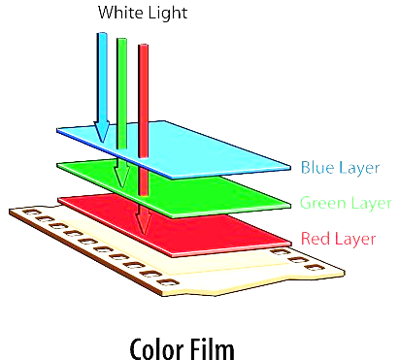
Channel
Color image is combination of three channel typically called RGB
Red Channel
Green Channel
Blue Channel

Slide 6
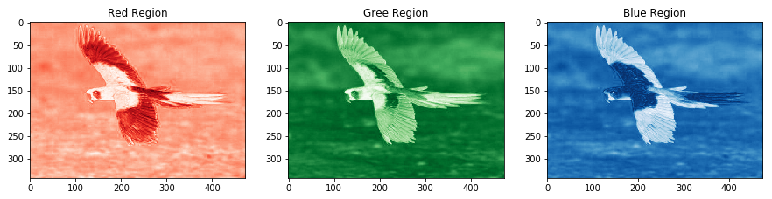
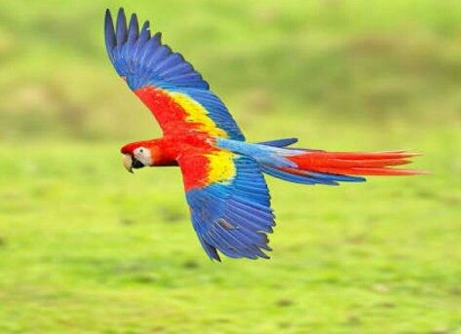
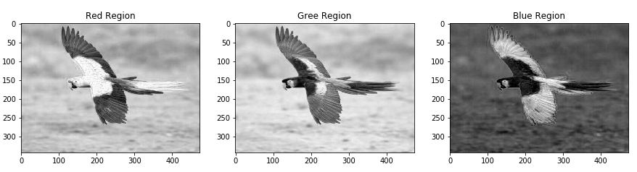
(343, 473)
(343, 473)
(343, 473)
(343, 473 , 3)
(343, 473)
(343, 473)
(343, 473)

Slide 7
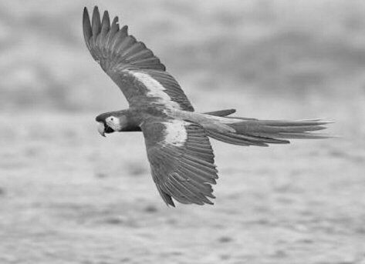

Grayscale$=\frac{R+G+B}{3}$
(343, 473 , 3)
(343, 473)
Length of matrix or array reduce by 3 times hence the computation time

Slide 8
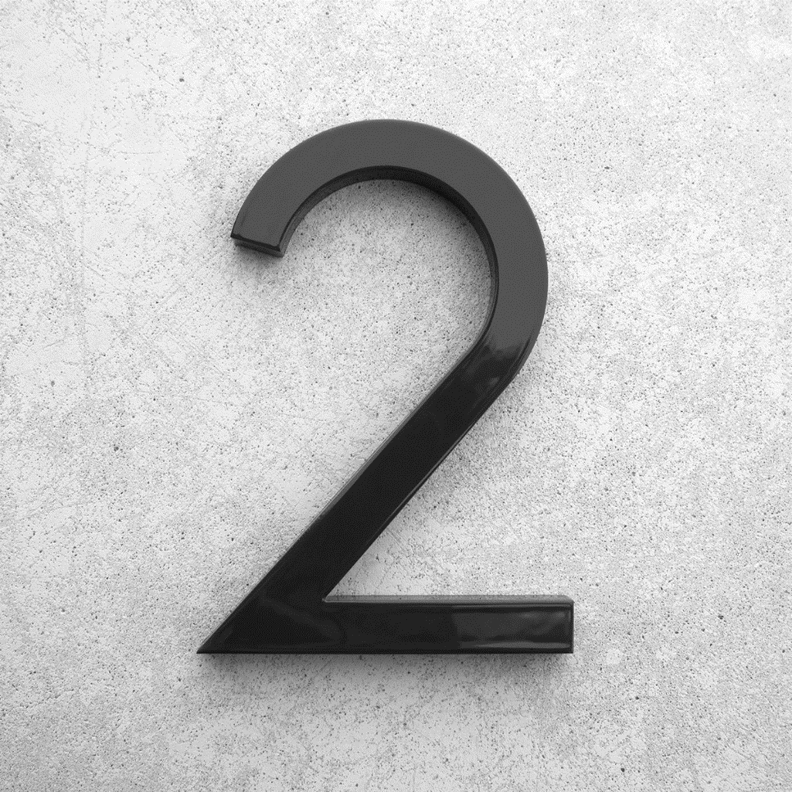
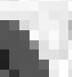
Deeper Into Image
246 | 250 | 251 | 255 | 230 | 225 | 201
210 | 255 | 230 | 225 | 201 | 225 | 201
6 | 21 | 230 | 225 | 250 | 251 | 255
7 | 10 | 12 | 255 | 230 | 225 | 201
3 | 8 | 10 | 75 | 250 | 251 | 255
0 | 6 | 7 | 9 | 250 | 251 | 255
0 | 12 | 23 | 11 | 15 | 190 | 192
3 | 5 | 6 | 7 | 9 | 196 | 199
200 x 200
PIXELS

Slide 9
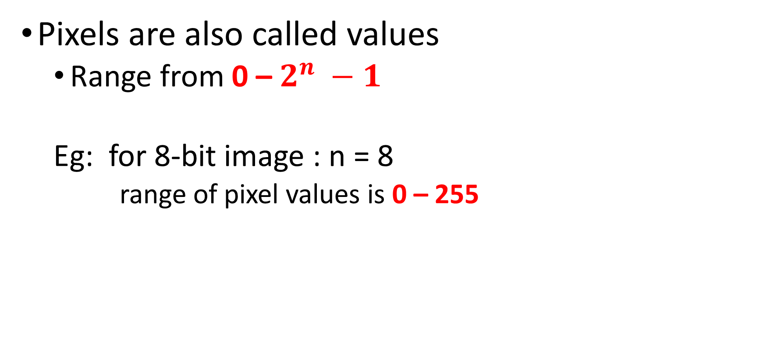
Pixels
Pixels are also called values
Range from 0 – $2^{n} −1$
Eg: for 8-bit image : n = 8
range of pixel values is 0 – 255

Slide 10
Pixels
Lower the value darker the color
Eg: black color for gray scale image
Higher the value lighter the color
Eg: White color for gray scale image
0
255

Slide 11
Pixels
246 | 250 | 251 | 255 | 230 | 225 | 201
210 | 255 | 230 | 225 | 201 | 225 | 201
6 | 21 | 230 | 225 | 250 | 251 | 255
7 | 10 | 12 | 255 | 230 | 225 | 201
3 | 8 | 10 | 75 | 250 | 251 | 255
0 | 6 | 7 | 9 | 250 | 251 | 255
0 | 12 | 23 | 11 | 15 | 190 | 192
3 | 5 | 6 | 7 | 9 | 196 | 199
200 x 200
PIXELS

Slide 12
Extracting Information from PIXEL

Slide 13
Information in Image
Skill of extraction information from data is called Data Science
Data Preprocessing
Data Analysis
Modelling

Slide 14
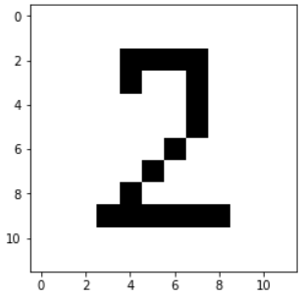
Data Preprocessing
Transforming the data into structured
Resize {Bring the all image into same shape}
Flatten
Converting into either row matrix or column matrix
(10, 10)
(1, 100)
Bar Code

Slide 15
Data Analysis
Number of black bars
Distance between each bars
Width of each bars
Position or index of bars
Train
Machine Learning Model
Features

Slide 16
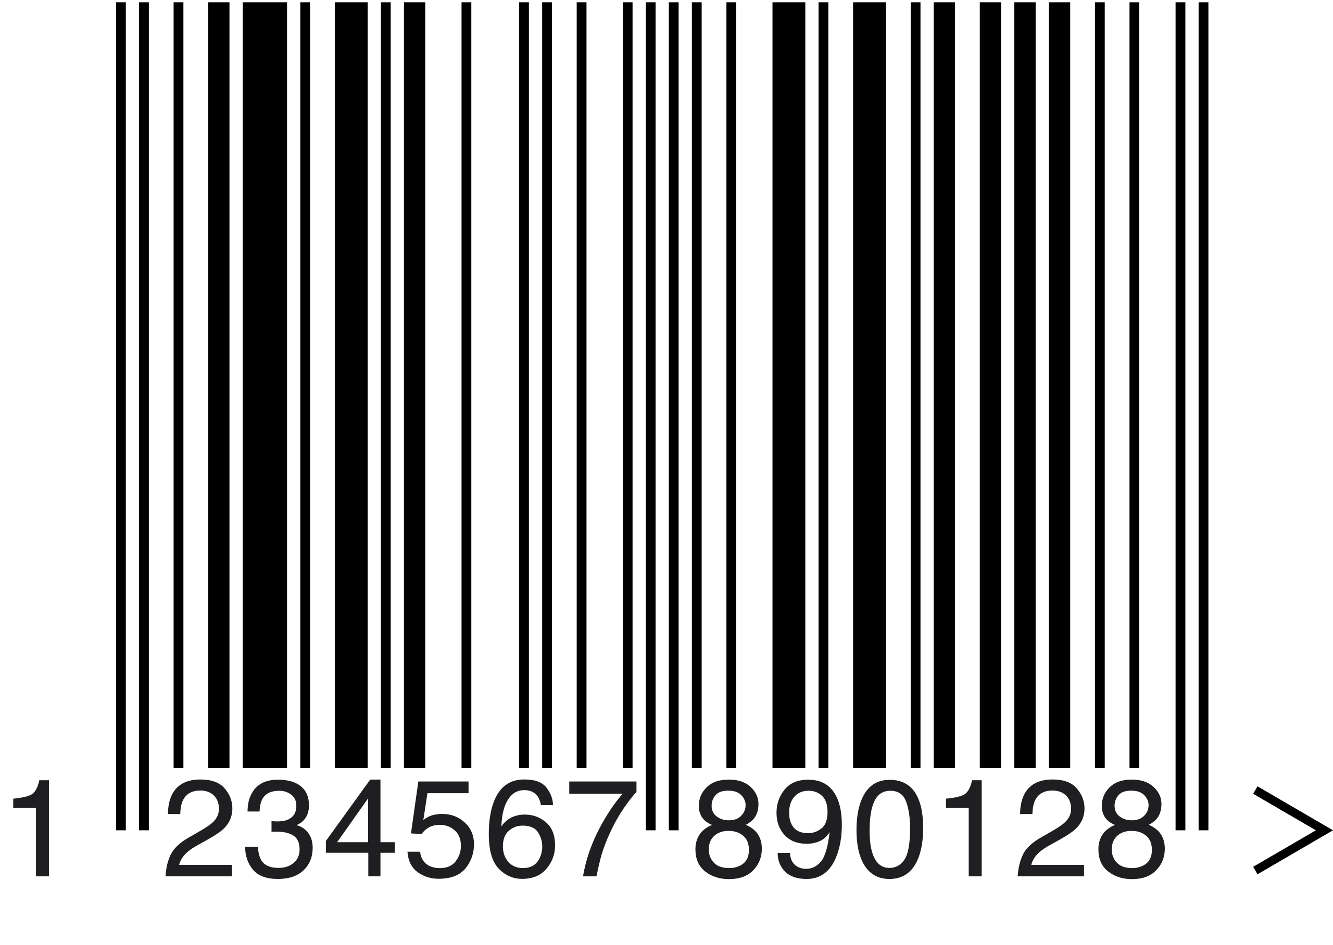

Slide 17
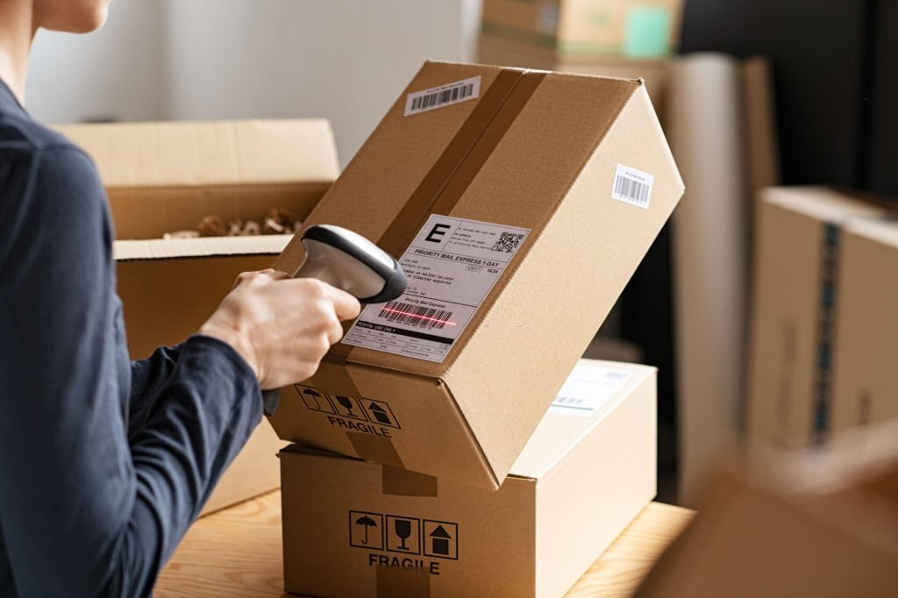
Machine Learning Model
Image

Slide 18
next
OpenCV

